Slide 1
Software testing
ehteshami, bahrami, saghali, ghasemi

Slide 2
Introduction
It is the process used to identify the correctness, completeness and quality of developed computer software.
It is the process of executing a program/application under positive and negative conditions by manual or automated means. It checks for the :
Specification
Functionality
Performance

Slide 3
Objectives
Uncover as many as errors (or bugs) as possible in a given product.
Demonstrate a given software product matching its requirement specifications.
Validate the quality of a software testing using the minimum cost and efforts.
Generate high quality test cases, perform effective tests, and issue correct and helpful problem reports.

Slide 4
Error, Bug, Fault & Failure
Error : It is a human action that produces the incorrect result that produces a fault.
Bug : The presence of error at the time of execution of the software.
Fault : State of software caused by an error.
Failure : Deviation of the software from its expected result. It is an event.

Slide 5
SDLC(Software Development Life Cycle)
Standard model used word wide to develop a software.
A framework that describes the activities performed at each stage of a software development project.
Necessary to ensure the quality of the software.
Logical steps taken to develop a software product.

Slide 6
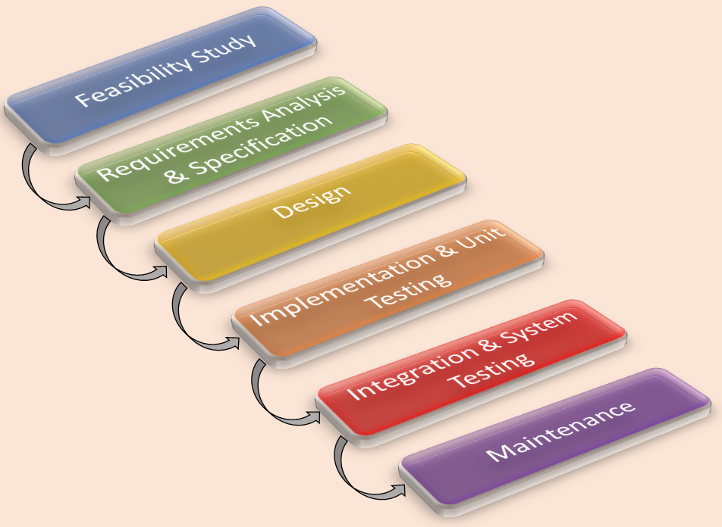
Classical Waterfall Model
It is the oldest and most widely used model in the field of software development.

Slide 7
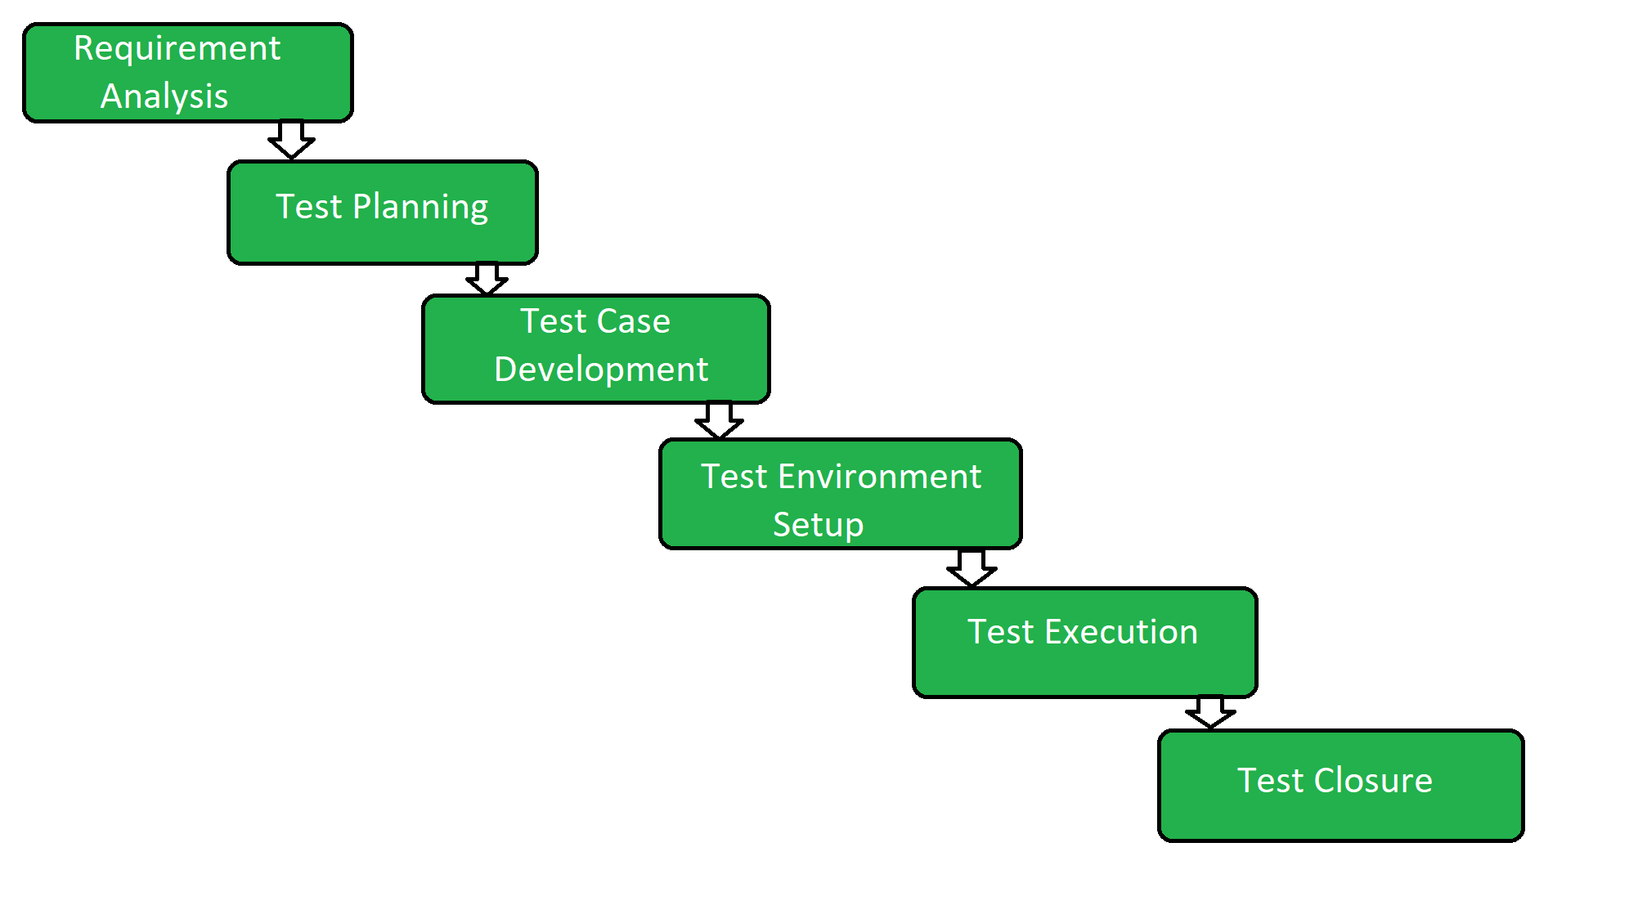
Testing Life Cycle

Slide 8
Requirement Analysis
Requirement Analysis is the first step of Software Testing Life Cycle (STLC).
In this phase quality assurance team understands the requirements like what is to be tested.
If anything is missing or not understandable then quality assurance team meets with the stakeholders to better understand the detail knowledge of requirement.

Slide 9
Test Planing
Test Planning is most efficient phase of software testing life cycle where all testing plans are defined.
In this phase manager of the testing team calculates estimated effort and cost for the testing work.
This phase gets started once the requirement gathering phase is completed.

Slide 10
Test Case Development
The test case development phase gets started once the test planning phase is completed.
In this phase testing team note down the detailed test cases.
Testing team also prepare the required test data for the testing.
When the test cases are prepared then they are reviewed by quality assurance team.

Slide 11
Test Environment Setup
Test environment setup is the vital part of the STLC.
Basically test environment decides the conditions on which software is tested.
This is independent activity and can be started along with test case development.
In this process the testing team is not involved. either the developer or the customer creates the testing environment.

Slide 12
Test Execution and Test Closure
Test Execution:
After the test case development and test environment setup test execution phase gets started.
In this phase testing team start executing test cases based on prepared test cases in the earlier step.
Test Closure:
This is the last stage of STLC in which the process of testing is analyzed.

Slide 13
Verification vs Validation
Verification
Validation
The software should confirm to its specification (Are we building the product right?)
The software should do what the user
really requires (Are we building the right product?)

Slide 14
Testing Methodologies
Black box testing
White box testing
No knowledge of internal program design or code required.
Tests are based on requirements and functionality.
Knowledge of the internal program design and code required.
Tests are based on coverage of code statements, branches, paths, conditions.

Slide 15
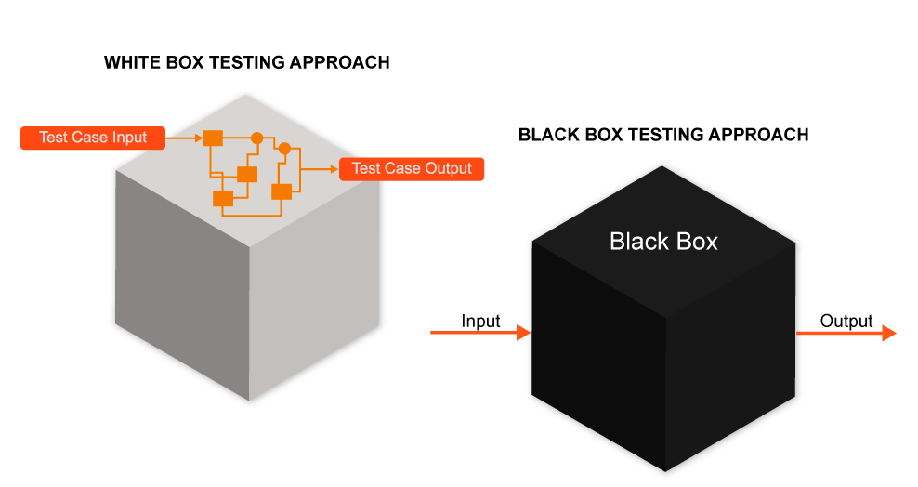
Testing Methodologies

Slide 16
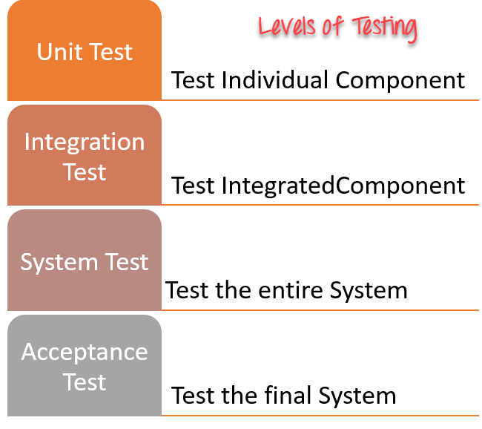
Testing levels

Slide 17
UNIT TESTING
Tests each module individually.
Follows a white box testing (Logic of the program).
Done by developers.

Slide 18
INTEGRATION TESTING
Once all the modules have been unit tested, integration testing is performed.
It is systematic testing.
Produce tests to identify errors associated with interfacing.
Types:
Big Bang Integration testing
Top Down Integration testing
Bottom Up Integration testing
Mixed Integration testing

Slide 19
SYSTEM TESTING
System testing is the first level in which the complete application is tested as a whole.
The goal at this level is to evaluate whether the system has complied with all of the outlined requirements and to see that it meets Quality Standards.
System testing is undertaken by independent testers who haven’t played a role in developing the program.
This testing is performed in an environment that closely mirrors production.

Slide 20
ACCEPTANCE TESTING
ACCEPTANCE TESTING is a level of software testing where a system is tested for acceptability.
The purpose of this test is to evaluate the system’s compliance with the business requirements and assess whether it is acceptable for delivery.
Done by end users
Types:
User acceptance testing
Operational acceptance testing
Contractual and regulatory acceptance testing
Alpha and beta testing

Slide 21
DISCUSSION
In order to be cost effective, the testing must be concentrated on areas where it will be most effective.
The testing should be planned such that when testing is stopped for whatever reason, the most effective testing in the time allotted has already been done.
The absence of an organizational testing policy may result in too much effort and money will be spent on testing, attempting to achieve a level of quality that is impossible or unnecessary.

Slide 22
resources
[1] Wikipedia
[2] reqtest
[3] tutorialspoint
[4] upwork
[5] sepidaria
[6] softwaretestinghelp
[7] software engineering :A practitioners approach 8th edition

Slide 23
thanks for listening

